Slide 1
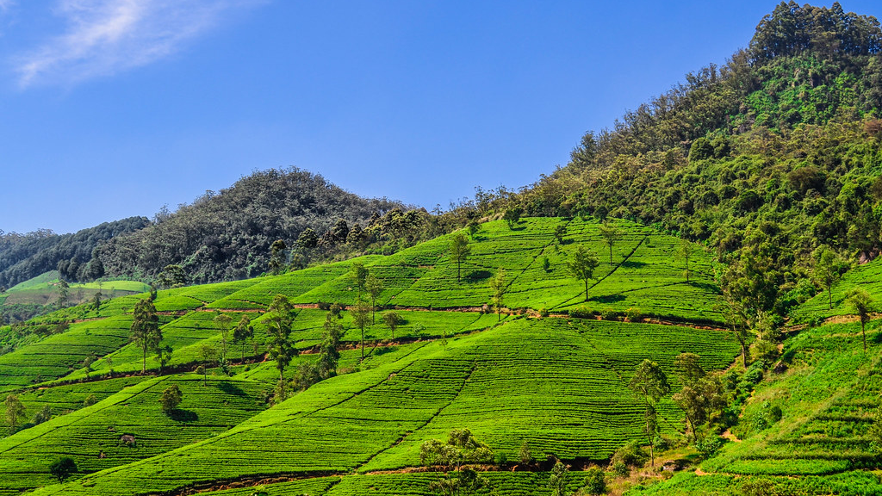
Sri lanka'n tea industry

Slide 2
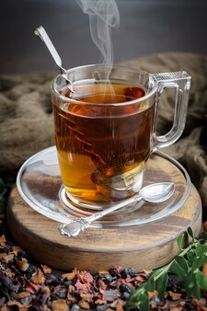
introduction
The final report presents strategies for enhancing Sri Lanka's tea export industry through improved grading, promotion, and sustainability measures, aiming to elevate its global competitiveness and secure long-term prosperity.

Slide 3
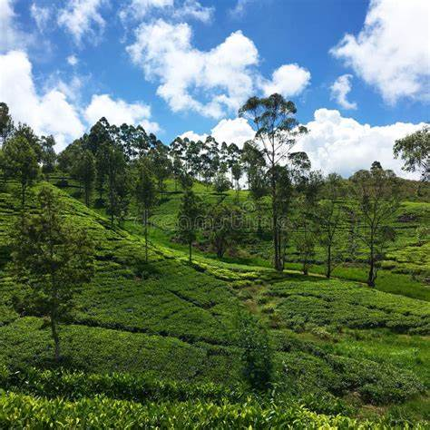
Tea quality grading

Slide 4
Suggested functionalities
Weakness - Traditional tea grading methods, reliant on human tasters, suffer from subjectivity and lack uniformity, leading to discrepancies in grading criteria among individuals or panels and hindering transparency and comparability across estates.

Slide 5
Suggested functionalities
Solution - In Sri Lanka, tea tasters utilize technology with digital grading forms for efficient and accurate assessment. Tailored templates cater to diverse tea varieties, while robust data security ensures integrity. This modernization enhances the grading experience, embraced by tasters with comprehensive training and support.

Slide 6
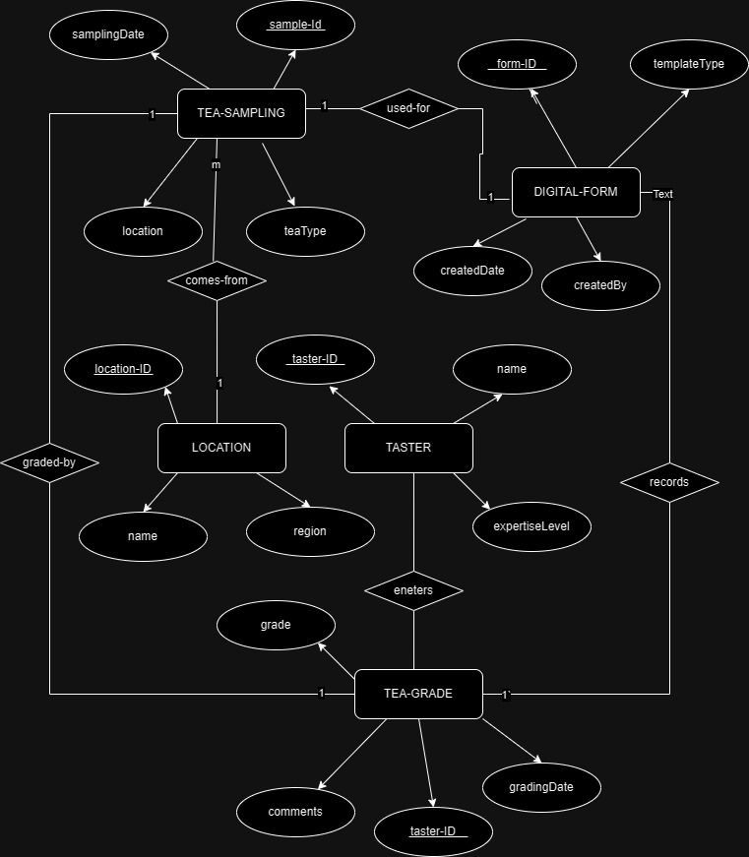
Er diagram

Slide 7
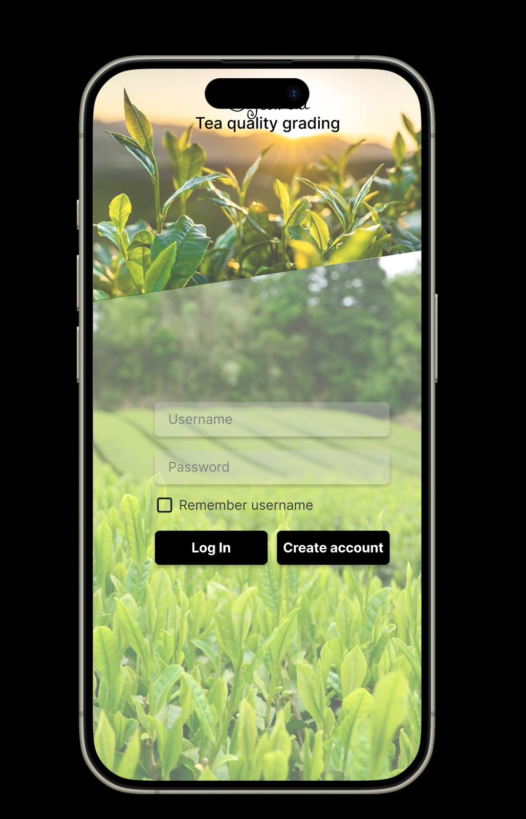
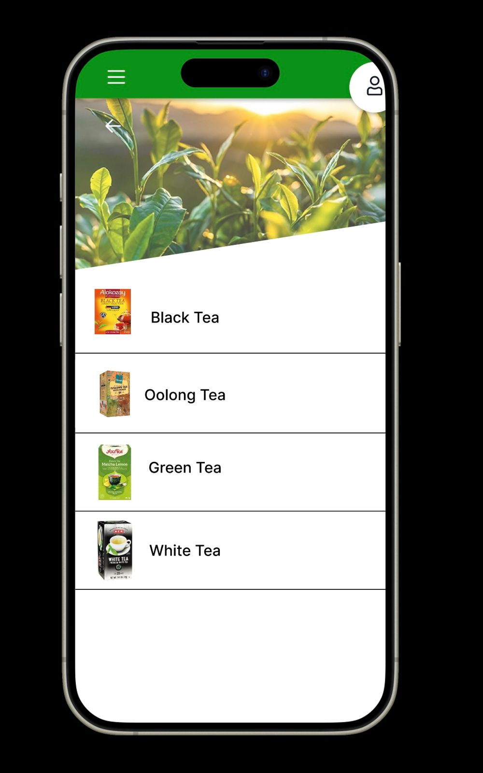
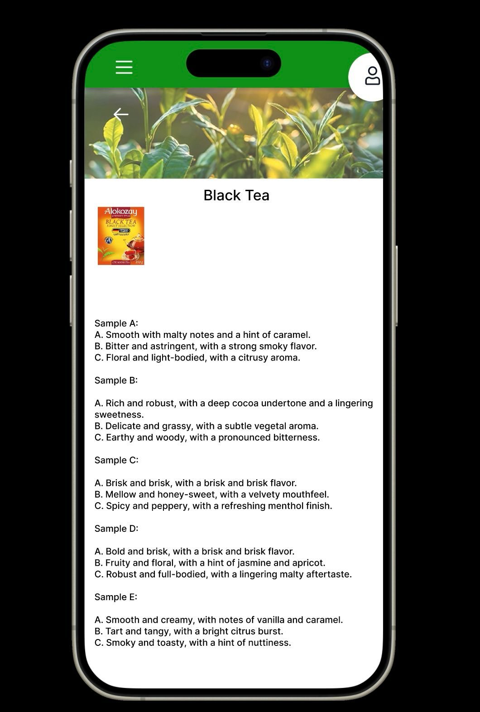
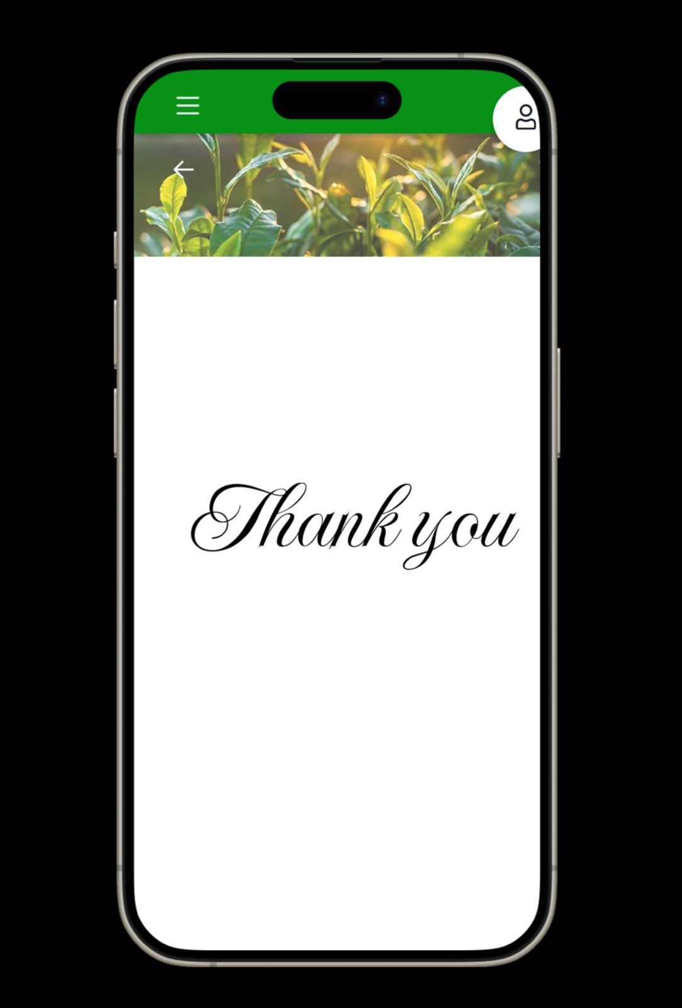
Ui designs

Slide 8
Flow of the functionalities
User authentication and access control
Tea sample registration
Grading forms selection
Real time grading
Offline evaluation support
Data security and integrity
Review and approval process
Reporting and analysis
Training and support
Continuous improvement

Slide 9
Hardware/software requirements
Hardware
Tablets or iPads
Networking Hardware
Backup systems
Software
Operating System
Database Management System
security Software

Slide 10
Special skills and knowledge required by the system users to work with
Technical Proficiency
Grading Proficiency
Data Entry Proficiency
Knowledge of Grading Criteria
Security Awareness
Instruction in System Usage
Technology Adaptability

Slide 11
Limitations of the system
The electronic tea grading system offers efficiency and standardization benefits over conventional methods but faces challenges like technical issues, connectivity issues, compatibility, learning curves, data security, scalability, costs, and cultural factors, necessitating strong support, training, and adaptability for successful implementation.

Slide 12
Promotion and tourism

Slide 13
Suggested functionalities
Weakness - Foreigners often overlook the tourism potential of Sri Lanka's tea factories, leading to missed revenue opportunities. Proper promotion of factory tours is crucial to attract travelers seeking firsthand tea manufacturing experiences and to capitalize on the industry's historical, cultural, and scenic resources for economic growth.

Slide 14
Suggested functionalities
solution - Virtual tours of Sri Lanka's tea factories and fields offer a solution to the lack of promotion and awareness of tea tourism. These immersive experiences allow global audiences to explore the tea production process, cultural significance, and historical background from home. Through company websites and marketing efforts, virtual tours effectively promote Sri Lanka's tea-growing regions, while aligning with sustainable tourism standards. Overall, they represent a progressive approach to enhancing global promotion and understanding of Sri Lanka's tea tourism offerings

Slide 15
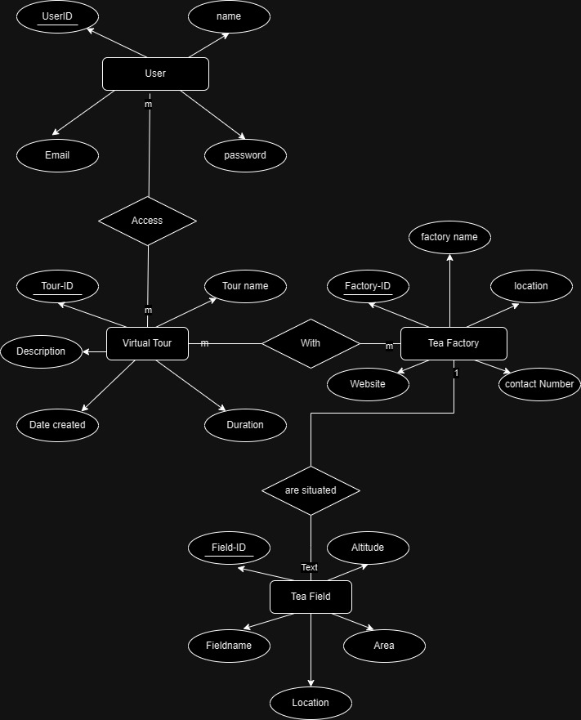
Er diagram

Slide 16
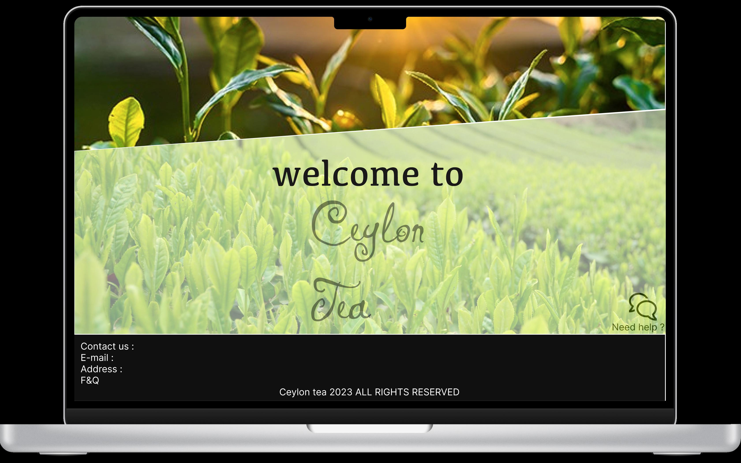
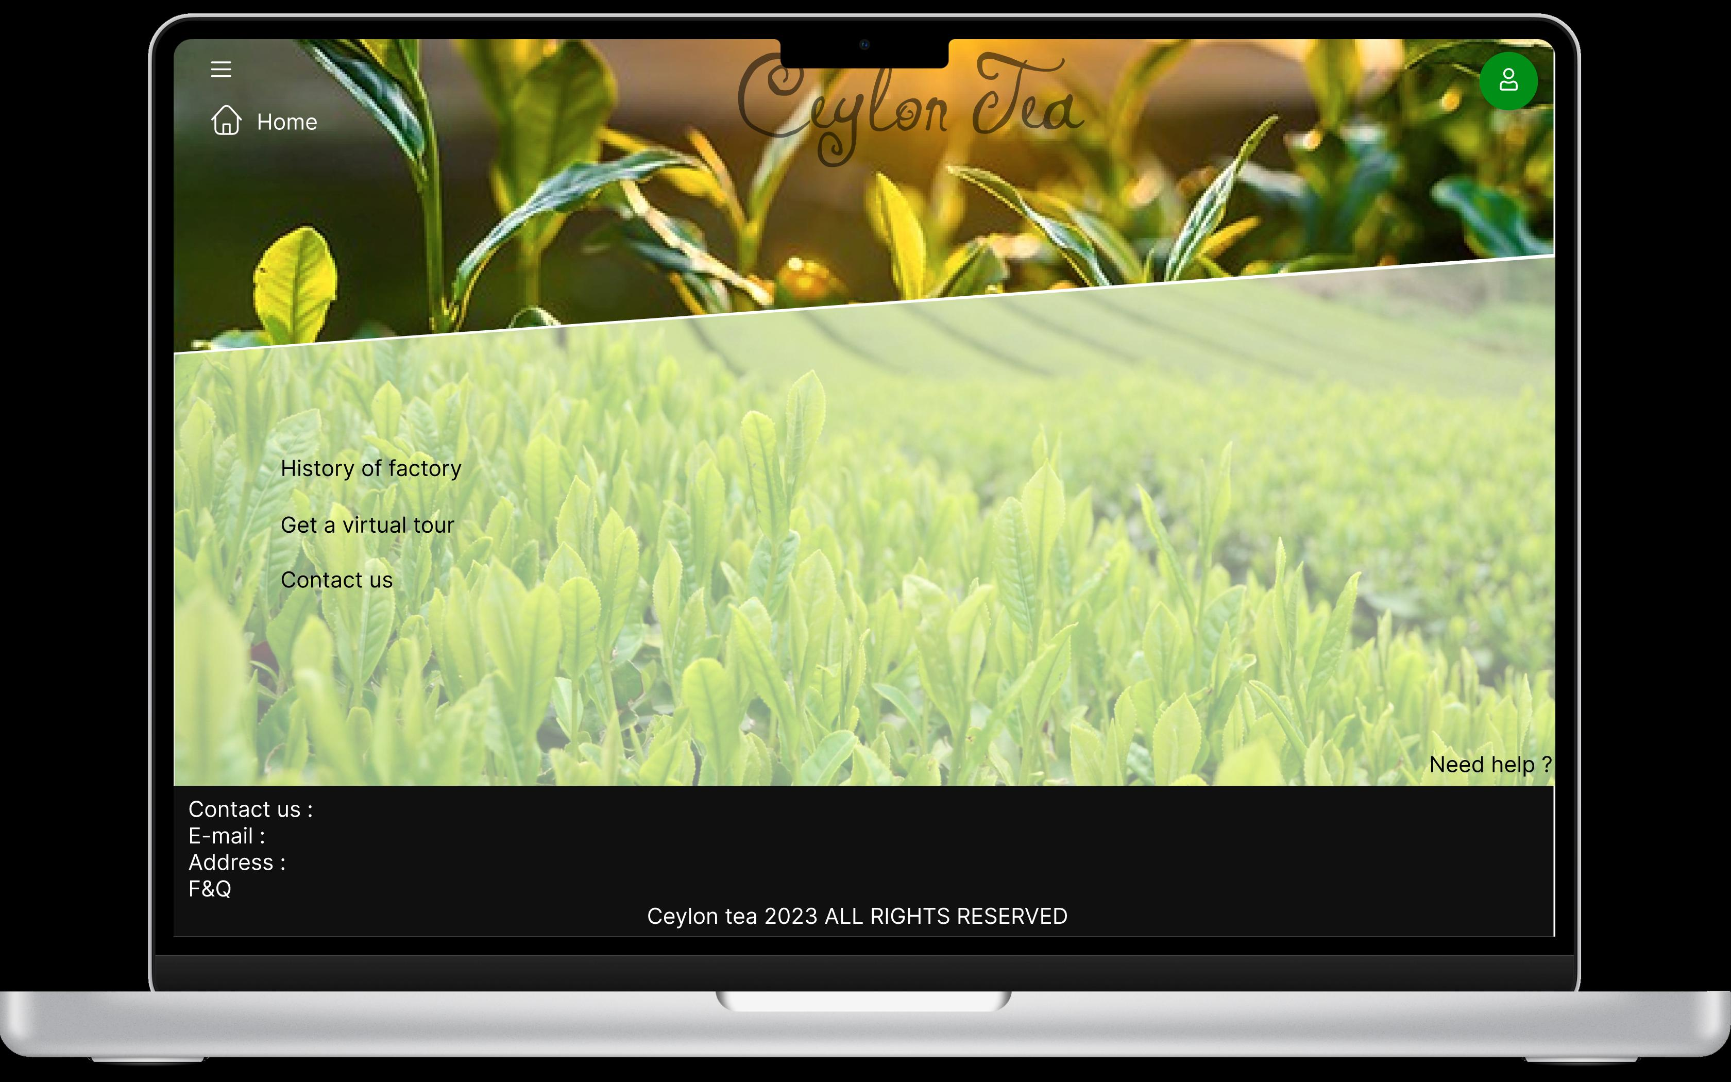
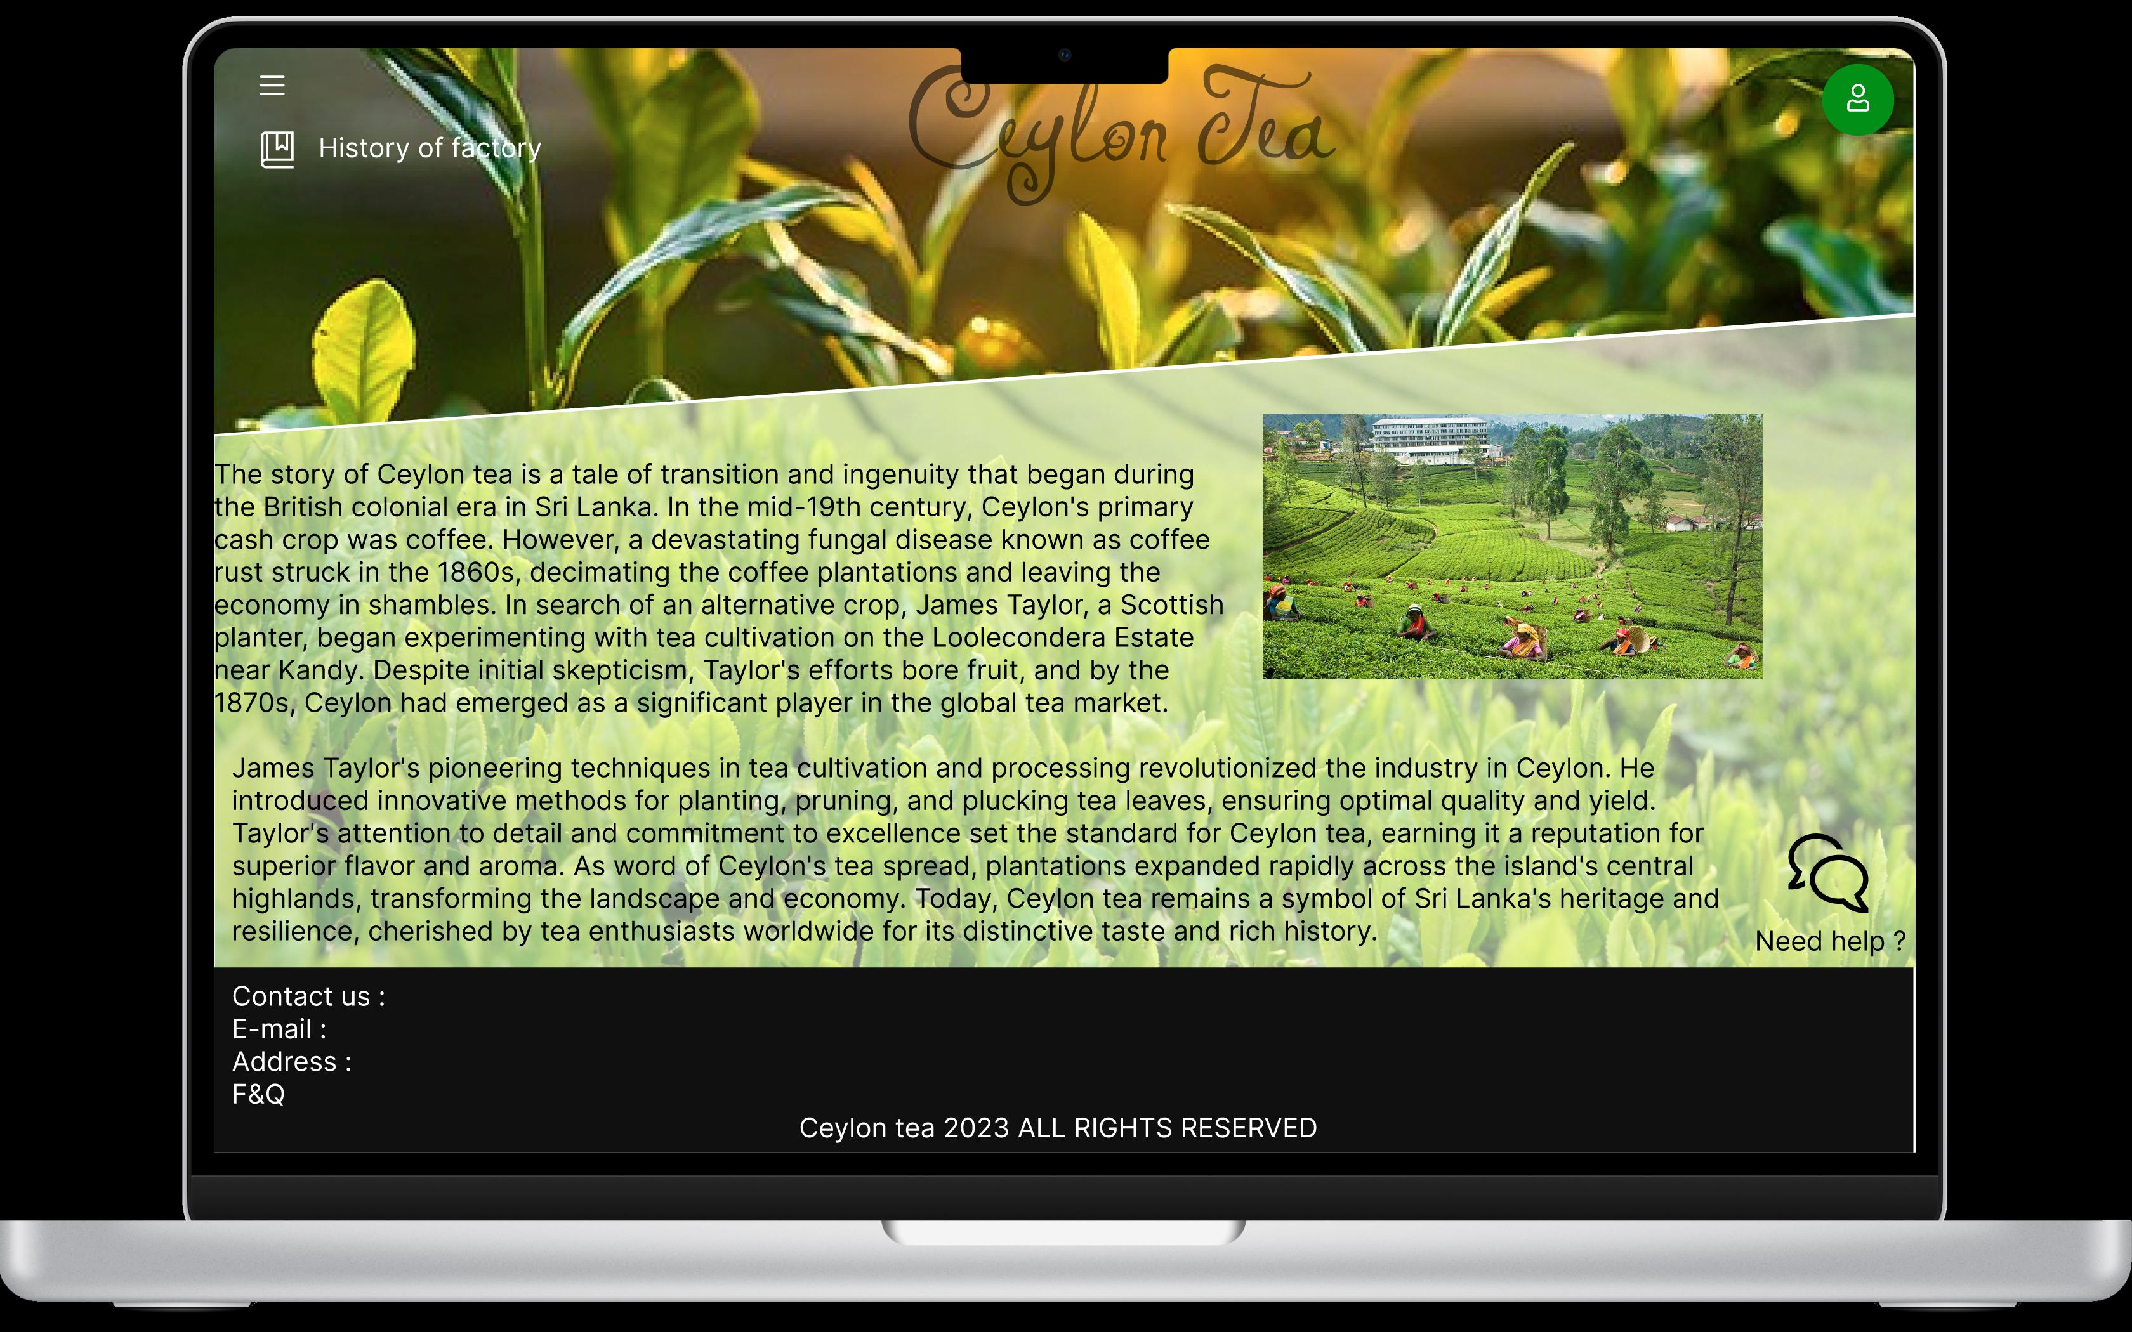
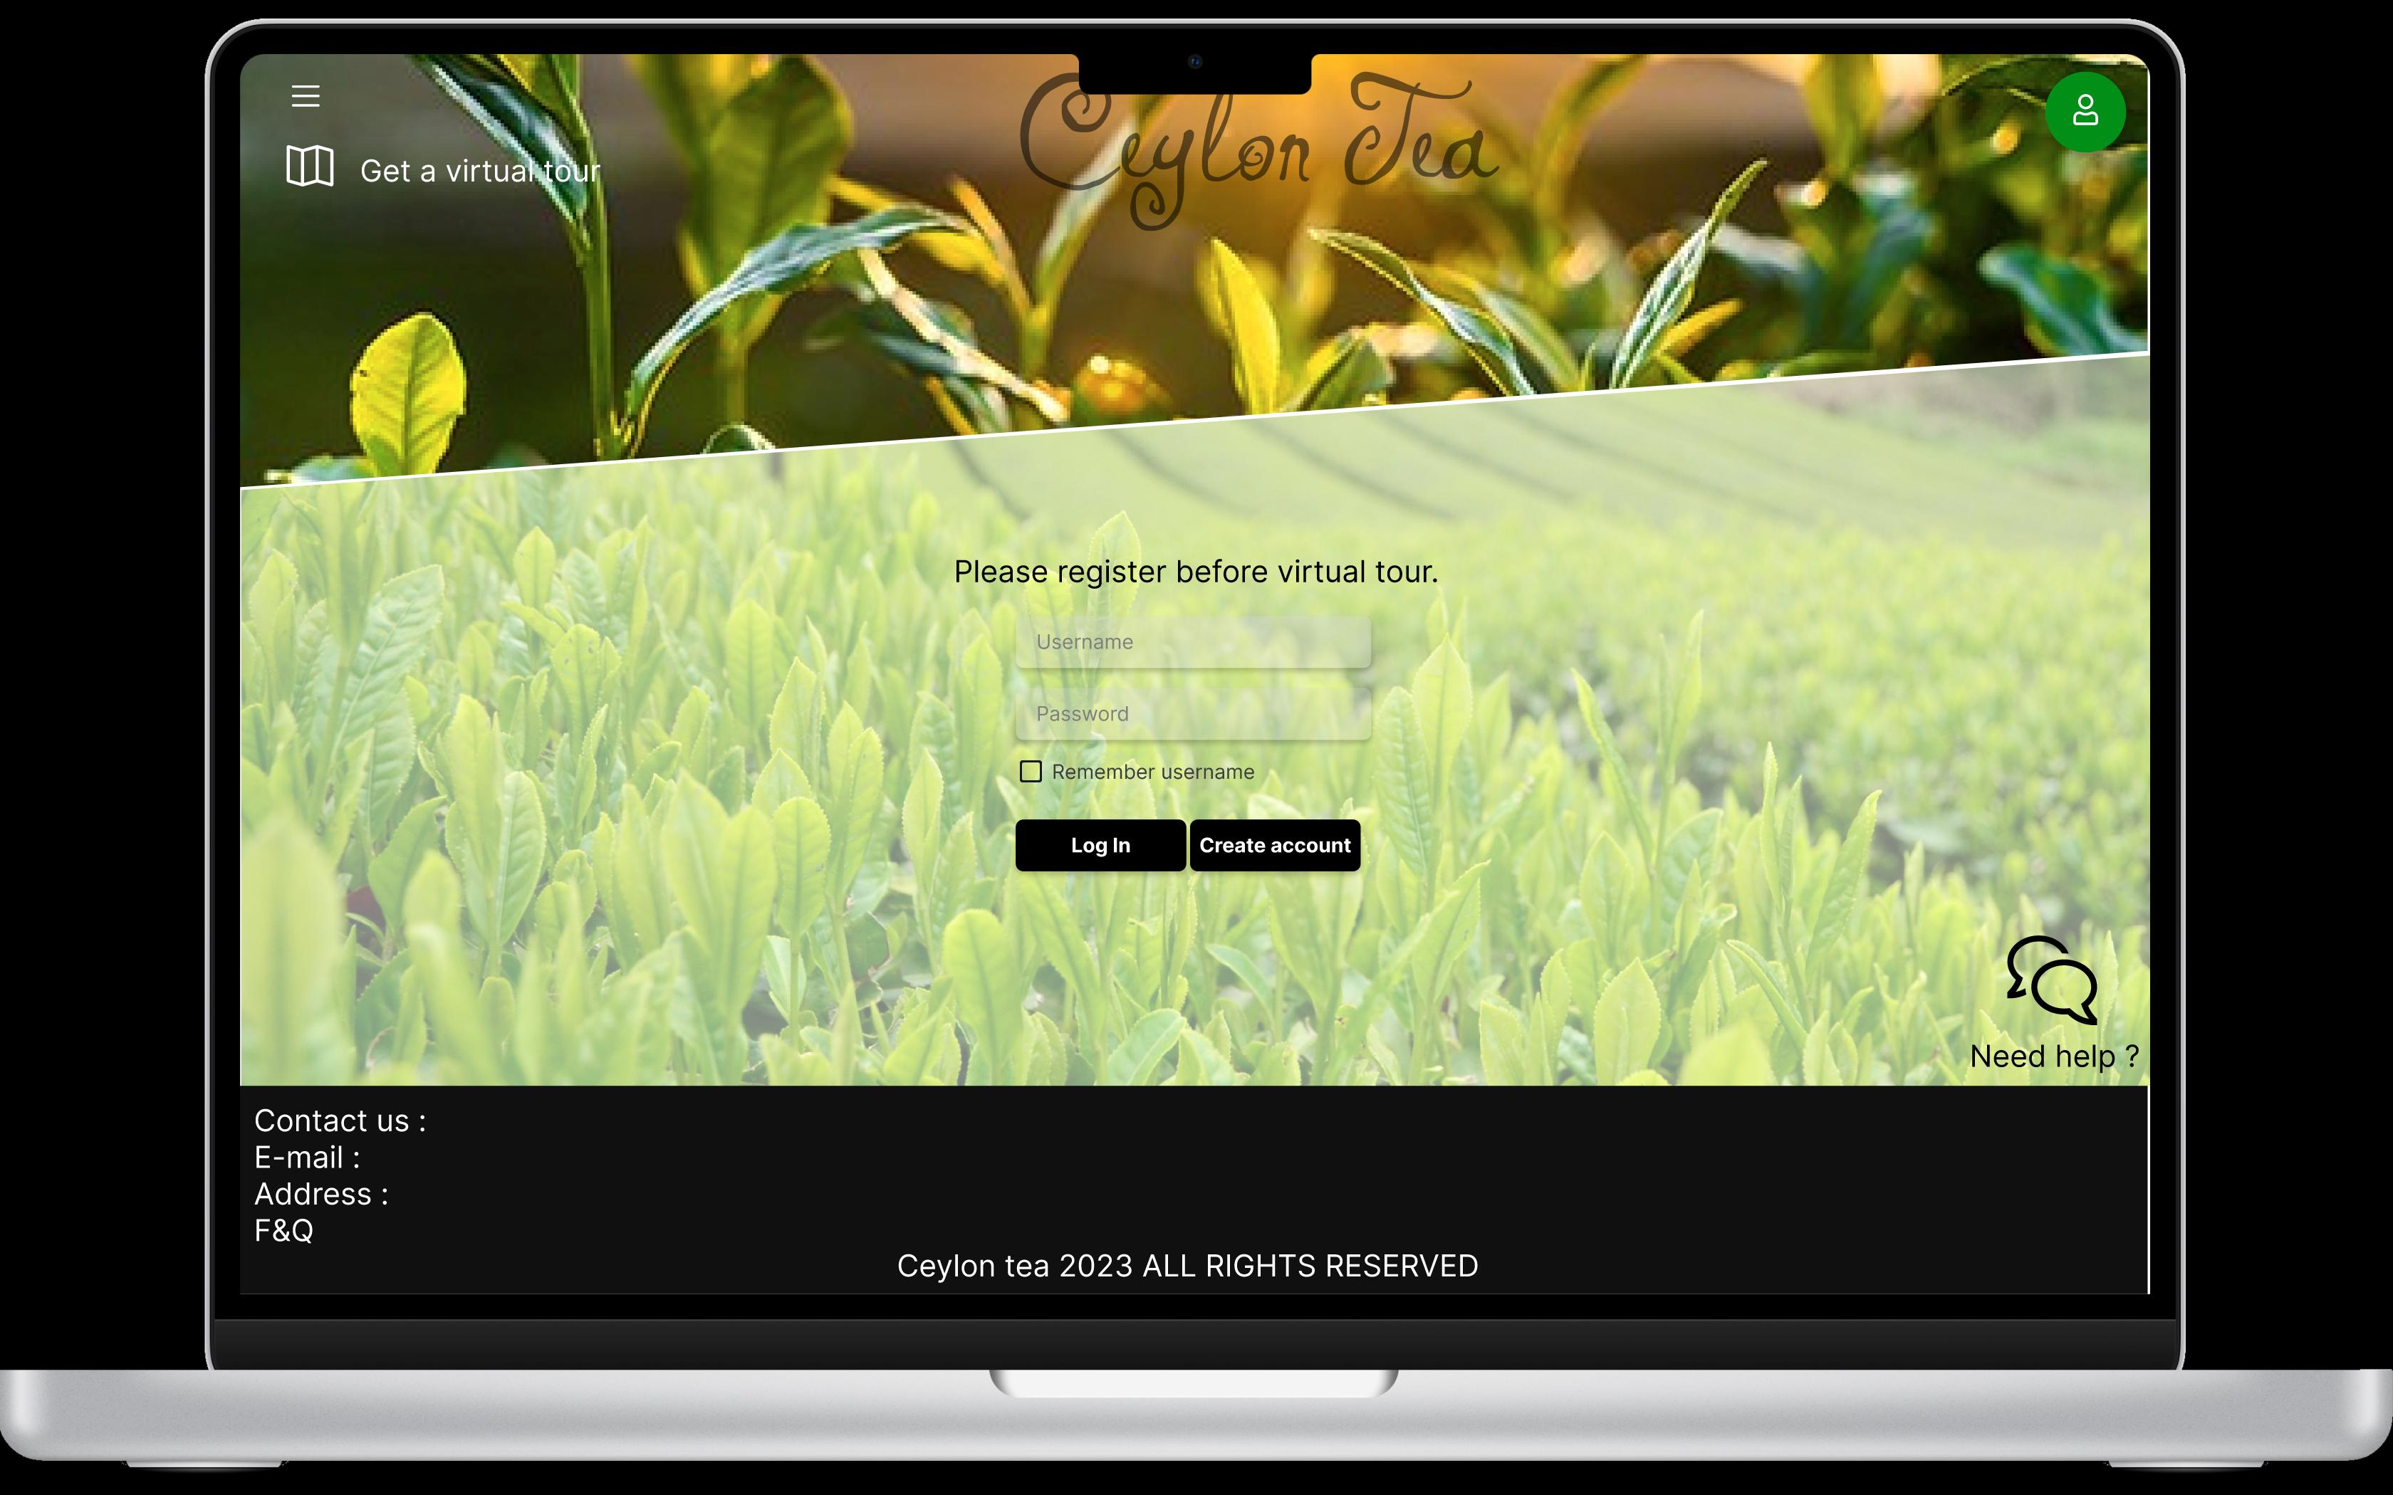
Ui designs

Slide 17
Flow of the functionalities
User interface design
Compatibility testing
Marketing strategy
Search engine optimization
Targeted outreach
Data collection
Performance evaluation
Continues updates
Content creation
Virtual environment creation
Interactive features
Accessibility considerations
Website integration
Feedback mechanisms
Community engagement

Slide 18
Hardware/software requirements
Hardware
server
Network Infrastructure
Computing Devices
Software
Virtual Tour Platform
Website Development Tools
Marketing and SEO Tools
Accessibility Tools
Software tools for producing multimedia content include image, audio, and video editing programmes

Slide 19
Special skills and knowledge required by the system users to work with
Expertise in creating virtual environments using 3D modelling, texturing, and animation utilising Unity or Unreal Engine software
Marketing experts
Analytics Experts
Managers of Community
IT and security administrators

Slide 20
Limitations of the system
Virtual tours for tea tourism in Sri Lanka, while convenient, depend on technology and internet access, limiting accessibility and failing to fully replicate in-person experiences. Complementary traditional marketing strategies are essential for maximizing their impact

Slide 21
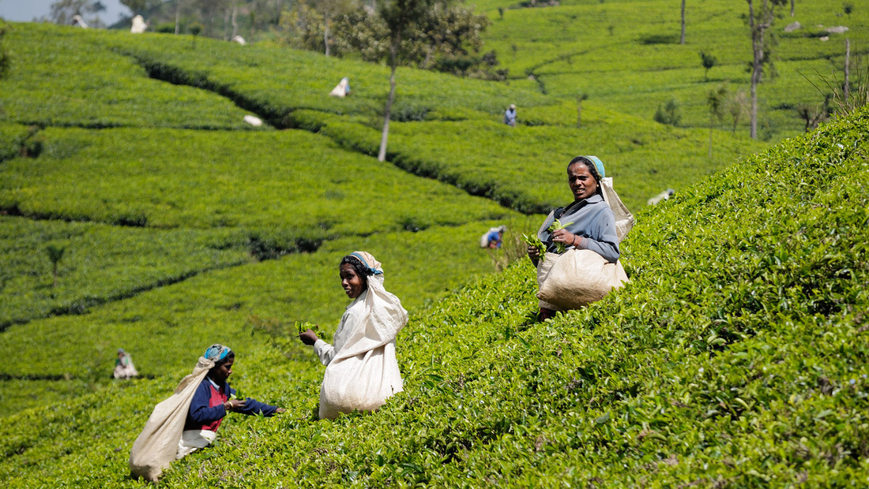
Thank you

